Slide 1
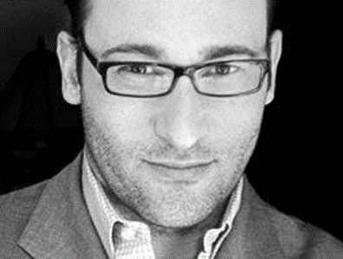
STARTING WITH WHY? BY SIMON SINEK
ust be together:

Slide 2
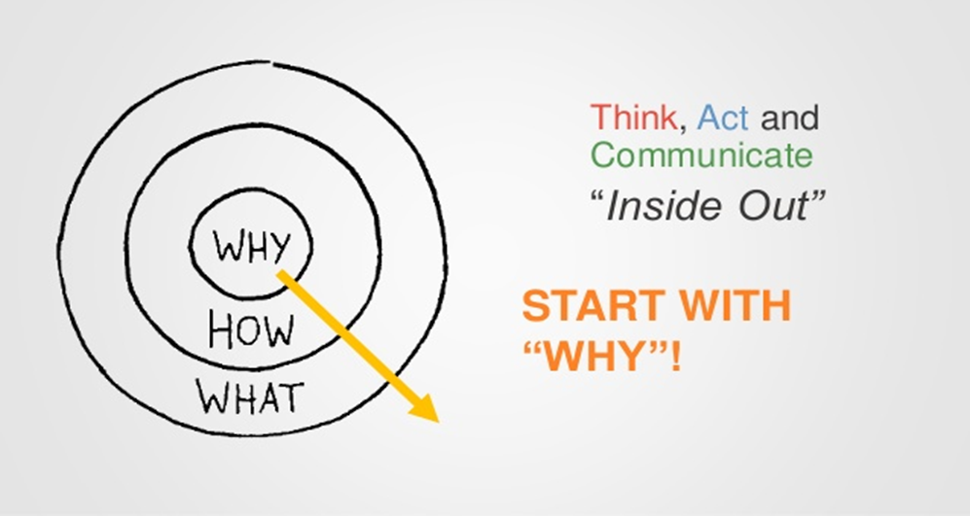

Slide 3
WHY, HOW ,WHAT
Must all be together:
Clarity of WHY.
Discipline of HOW-
principles that guide your actions,decisions of day-to-day/they are true differentiators of your product/services.
Consistency of WHAT-
Is the everything that you produce/includes your product and services.

Slide 4
Reasons for starting with WHY
Gives your followers and customers away to identify with you on a personal level.
If your WHY matches with their WHY:
They will be willing to with you through thin and thin.

Slide 5
Examples of companies and people that started with WHY
Leaders like Martin Luther King Jnr,Harley Davidson.
Companies like Apple,South west Airlines.
They started companies and movements and they incredibly loyal followers and customers
What separates them from others ,they started with WHY.

